Slide 1

Hotel Rating Classification
Mentor Name: Mr. Karthick Muskula
Group No: 6
Start Date: 28 Sep 2023

Slide 2
Group 6
Mr. Sriharsha Noorbhasha
Mr. Akshay Haridas Rautray
Ms. Jayshree Ramesh Bhoyar
Ms. Devangam Ramya
Mrs. Afrin Fathima
Mr. Chintha Gangadhara
Mr. Yash Vijay Salokhe
TEAM
MEMBERS

Slide 3
Business Objective :
The objective of the analysis is to build a model that classifies customer reviews based on their sentiment and the attributes that travelers are considering while selecting a hotel. The insights derived can help manager understand which elements of their hotel influence more in forming a positive review

Slide 4
1
2
3
4
5
6
Project Flow
Understanding Business Problem
EDA & Preprocessing
Sentiment Analysis
Feature Extraction
Model Building
Deployment

Slide 5
DataSet Details
There are 20491 entries present in the dataset, consisting two columns Review (object) and Rating (int).
There are NO null entries.
Ratings range from 1-5, 5 being the highest and 1 the lowest.
The count of each Rating is as follows
5 – 9054 entries
4 – 6039 entries
3 – 2184 entries
2 – 1793 entries
1 – 1421 entries

Slide 6

Exploratory Data Analysis (EDA)

Slide 7
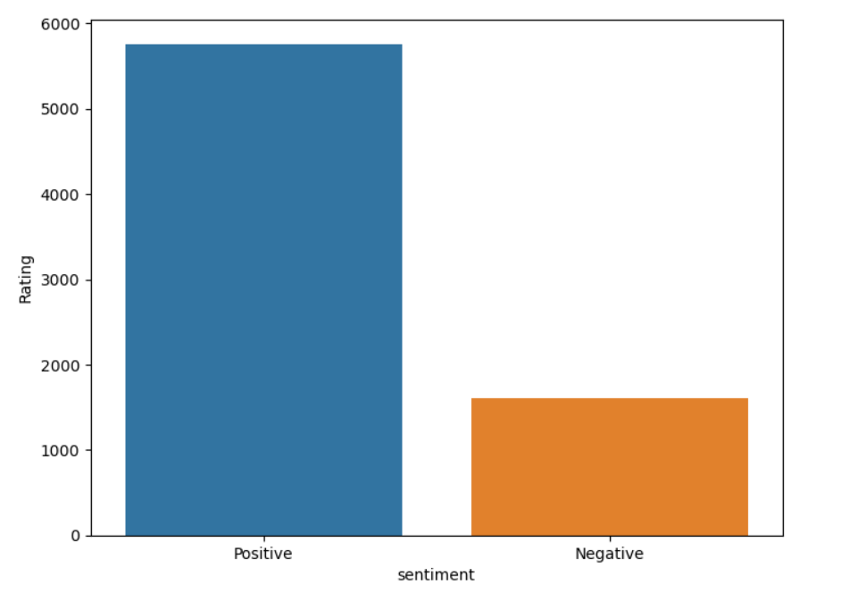
Assumptions
1
What exactly is a positive or negative review?
For this analysis we will be considering Rating 4 and 5 as a positive review and the rest as negative review.
Distribution of reviews/sentiment based on our assumption

Slide 8
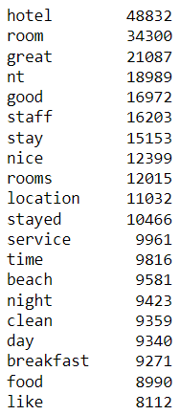
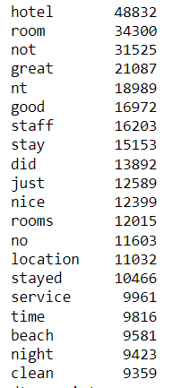
Before
After
Removing Stopwords
Stopwords such as “the”, “a”, “an”, “in” doesn’t provide us with any helpful insights. We would not want these words to take up space in our database, or taking up valuable processing time. So we remove them.

Slide 9
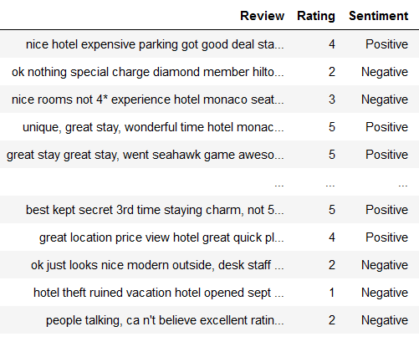
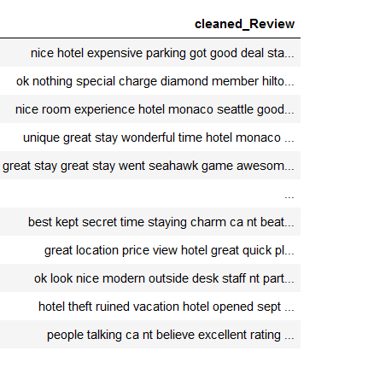
Preprocessing
Before
After

Slide 10
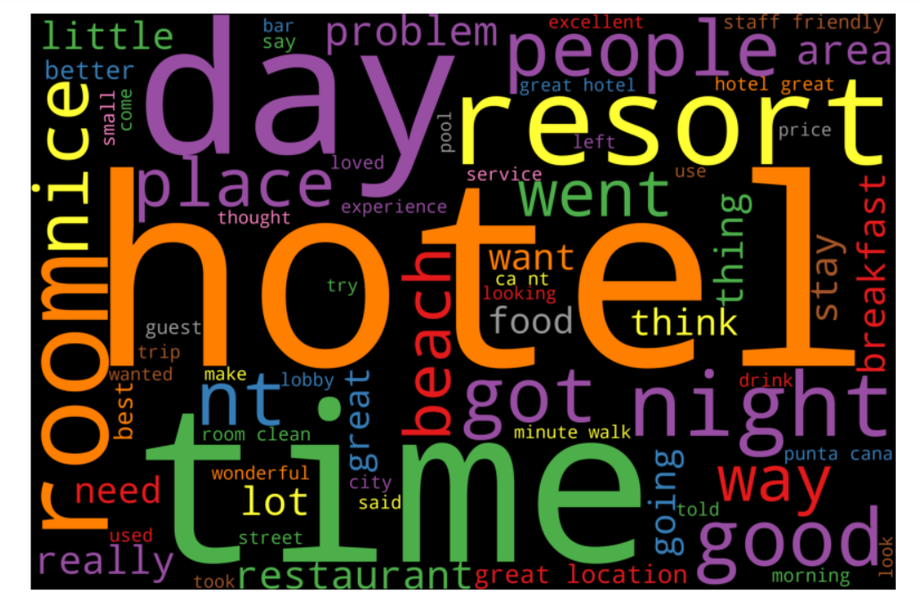
Word Cloud with Cleaned Reviews

Slide 11
3
Sentiment Analysis

Slide 12
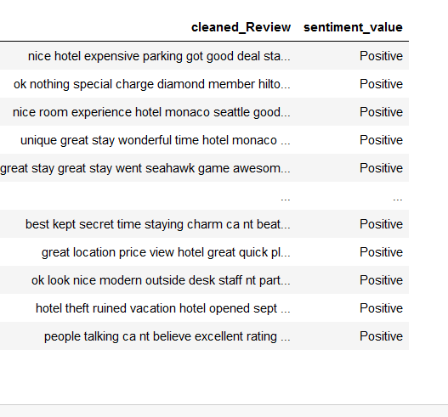
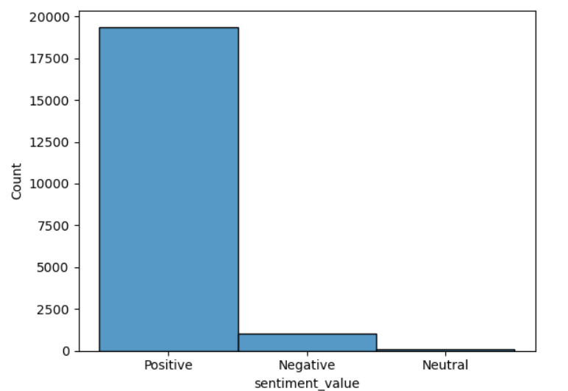
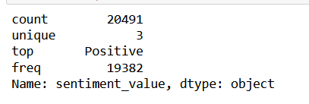
Location
Specialization
60%
40%
America
Europe

Slide 13

4
Feature Extraction

Slide 14
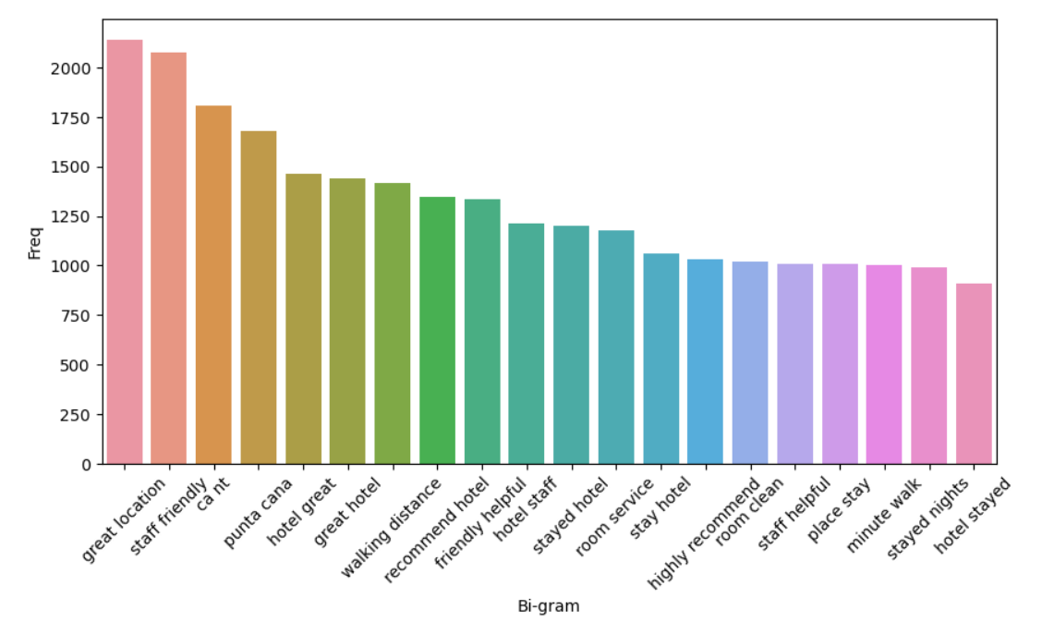
N-Grams (ngrams)
N-Grams are continuous sequences of words or symbols, or tokens in a document. In technical terms, they can be defined as the neighboring sequences of items in a document. We use it to find how many times particular combination of words have been used, which gives us more insight about a topic
Bi-gram is a combination of two words that have a distinct meaning

Slide 15
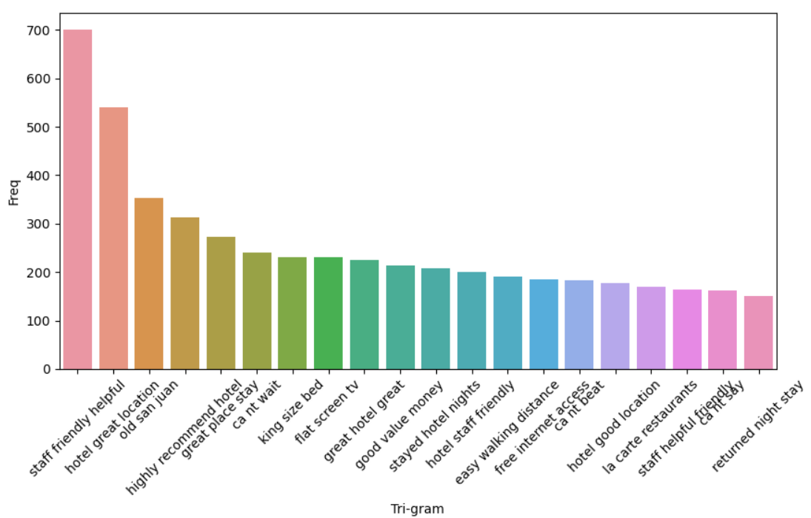
Similarly, Tri-gram is a combination of three words that combine to form a distinct meaning

Slide 16
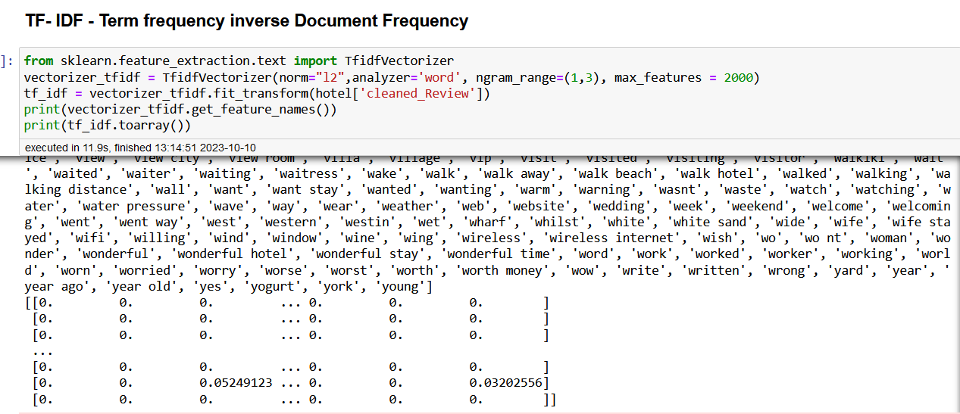
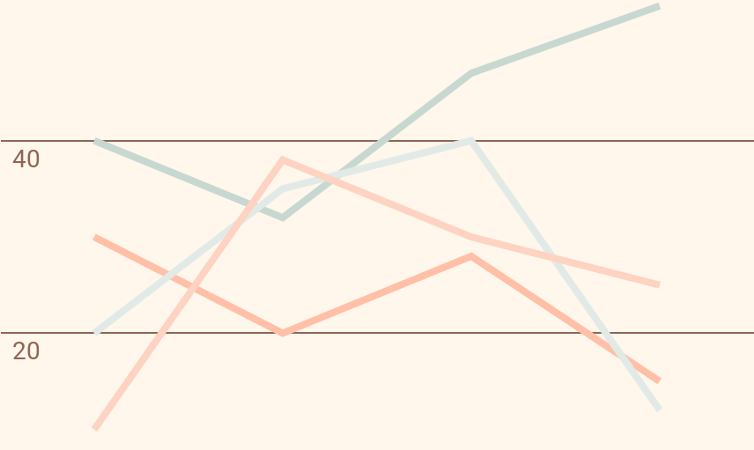
TF-IDF Vectorization
Jupiter
Mercury
Venus
Mars
Jupiter is the biggest planet in the Solar System
Mercury is the closest planet to the Sun
Venus is even hotter than Mercury
Despite being red, Mars is a cold place
To modify this graph, click on it, follow the link, change the data and paste the new graph here

Slide 17
Trainning Set
I
Testing Set
II
Data Split
Splitting the data set:
X – independent variables (Cleaned_Reviews)
Y- dependent variable (Sentiment_values)
2. Data is splitted in Train and test (20%)
16392 no. of observations
4099 no. of observations

Slide 18
05
Model Building

Slide 19
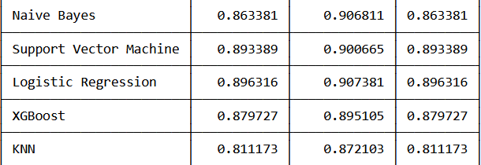
Model Evaluation
Model Name
Accuracy
Precision
Recall

Slide 20
Conclusion
We can conclude from our results that Support Vector Machine should be selected as best classification model to predict future reviews.
89%
Support Vector Machine

Slide 21
06
Deployment
using Streamlit

Slide 22
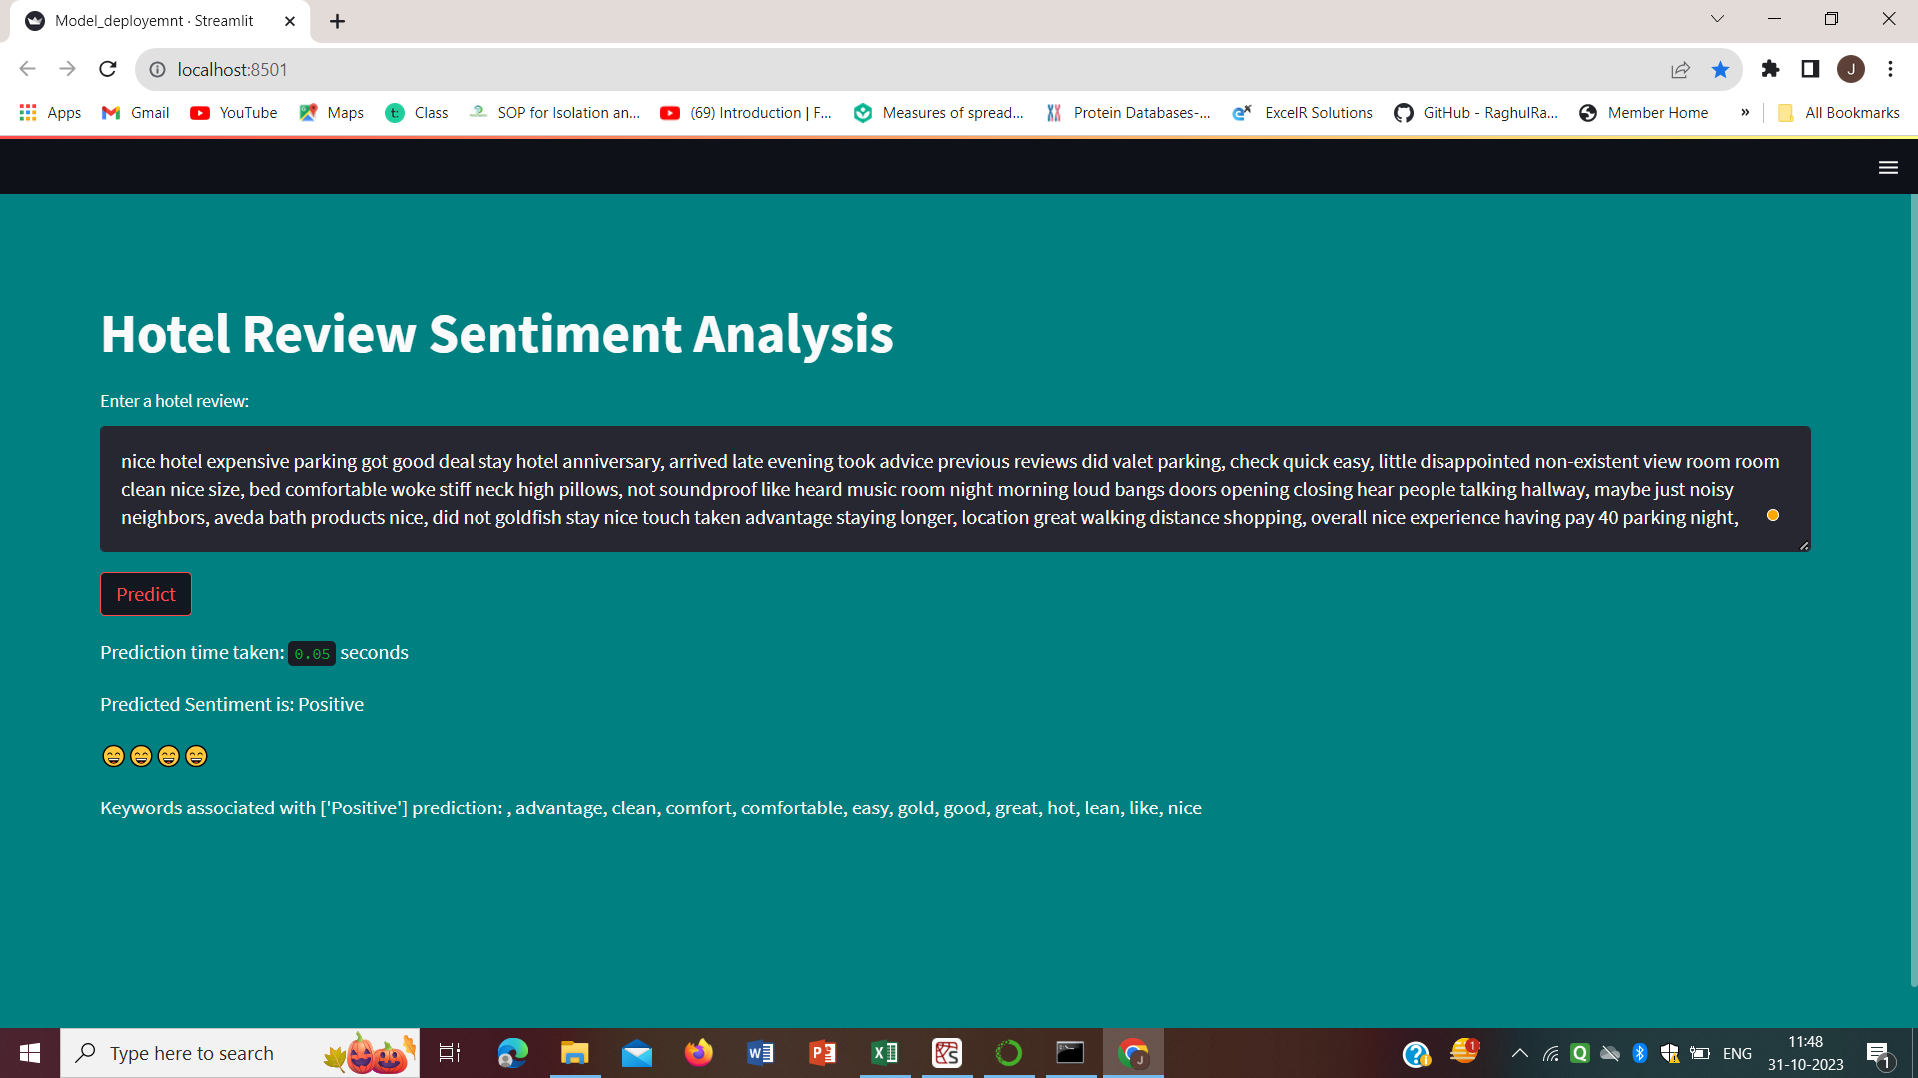

Slide 23
Challenges
Communication: As we all are from different walks of life, at the beginning it was difficult to communicate ideas but we overcame it and bonded pretty well.
Pre-processing: Choosing the most efficient method to lemmatize the reviews.
Sentiment Analysis: To choose appropriate sentiment analysis method.
Solution: Vader Sentiment
Feature Engineering: Representing text data effectively is essential for Model Building.
Solution: Utilized techniques like TF-IDF, Word Embeddings and N-grams to convert text into numerical features.

Slide 24
Challenges
Model Selection: Deciding which unsupervised model to use for predicting the sentiment was a challenging task. Different models have different strengths and weaknesses.
Model Evaluation: Choosing the right evaluation metrics to assess the SVM model's performance can be tricky.
Solution: We used a combination of metrics, including accuracy, precision, recall, F1-score, based on our specific project goals.
Deployment: Integrating our model using streamlit, ensuring it runs reliably in real-time, and make it user friendly.

Slide 25
Thank You

